Slide 1


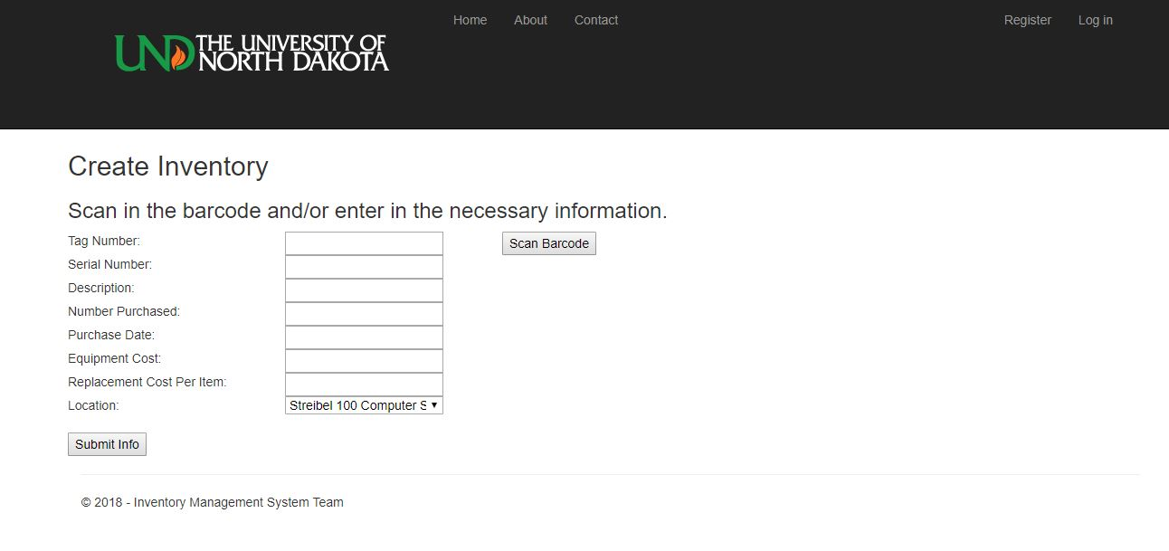
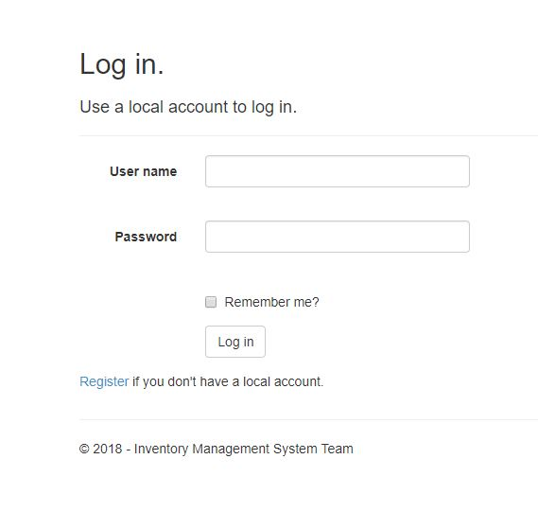
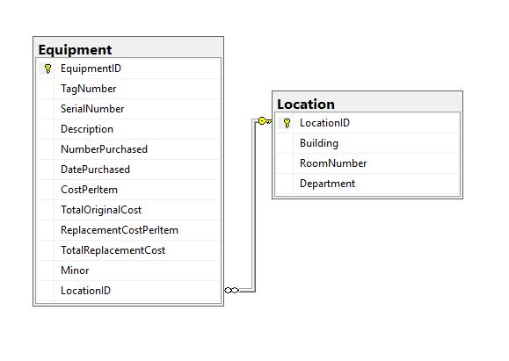
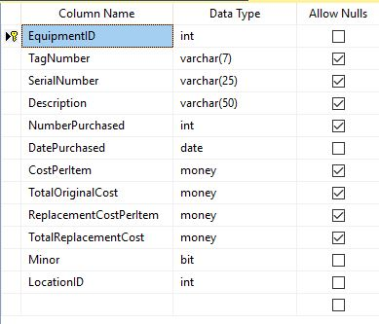
Developing A Web and Mobile Based Inventory Management System in ASP.NET August Davis, David Erickson, Christian Hanson Advisor: Emanuel Grant
Spring 2018 Design Exposition
Abstract:
Currently the University of North Dakota Computer Science department (UND CSCI) tracks its equipment via an Excel spread sheet. Under the current system each piece of equipment is given a barcode representing a unique identification number which then then must be manually added to the inventory spread sheet. This is a time-consuming task combined with the access issue presented with storing this information in a single spread sheet file makes the current system inefficient and to an extent risky to use. This project is aimed at replacing the current system with one that will allow multiple users appropriate access to the inventory data, as well as speed up the entry process by scanning each items barcode with a phone camera. To accomplish this, a web application was built to provide an interface for the user to access the different functions. From this application, they are able to create, delete, view, update, and locate inventory given the correct permissions
Diagram 3: Create inventory Page
Diagram 1: Home Page
Barcode Scanning:
On android scanning is handled by a call to the external app “XZing Barcode Scanner”
On PC scanning is handled by a USB hand scanner
No scanning available on non android phones
Interface:
Made using Asp.net frame work
Designed to work on mobile
Complies with UND design standards
Allows for easy navigation between features via navigation bar
Diagram 4: Database Diagram
Diagram 5: Equipment Table
Diagram 2: Login Page
Future work:
Setting up a hosting server
Further optimizing the interface for mobile
Adjusting the interface to follow more UND standards
Converting the data from the old system to this one
Adding a scanning option for IOS
Adding updating and deleting of locations
Creating audit reports with Report Wizard tool
Prepping for Future Development:
Set up scripts and explanation documents have been written for database set up.
Most the code pages have explanation headers and further explanation comments
Backend Database:
Microsoft SQL Server is used for storage of inventory and account information.

